Slide 1

Pacman’s Pursuit
BY:
Tiffani Buck
&
Monica Tucker

Slide 2

Object of the Game
Get from the bottom of the screen to the top of the screen to get the food.
Move through the ghost guarding the food
If you are touched by a ghost you lose.
Once you reach the top, eat the food and you win.
Pacman’s Food
Clyde the Ghost

Slide 3

How to Play
Move the cursor from the bottom of the board to the top of the board
Avoiding the ghost as you go.
Once you reach the food at the top, click on it to win.

Slide 4
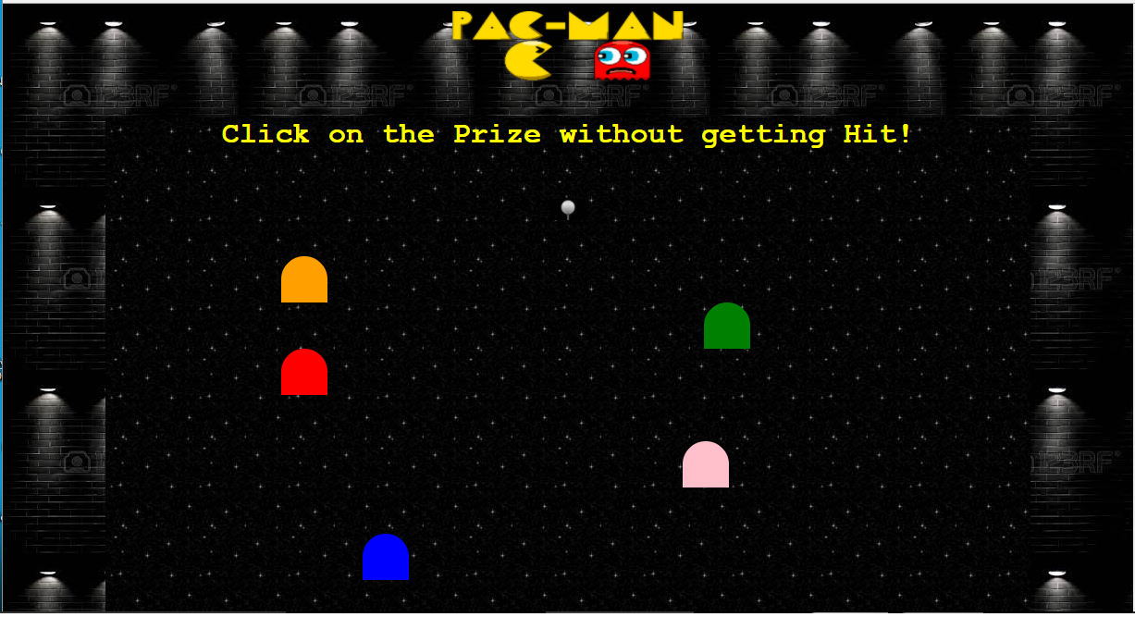
Main Screen – Game Board

Slide 5
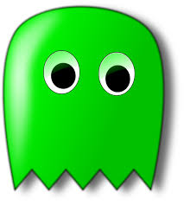
Game – HTML code
The main HTML page is minimal. We specify the headings and the ghosts as well as the “You Won” location, and we were able to keep the style contained in the CSS page.
<!DOCTYPE html>
<html>
<head>
<link rel ="stylesheet" type="text/css" href="pacman.css">
<title> Pacman's Pursuit </title>
</head>
<body class=home_page>
<img class="container1" src="pactitle.png" alt="title">
<div class="board">
<p id="text" >
<h1>Click on the Prize without getting Hit!</h1>
<div id="axis" class"four"></div>
<div class="container2" id="prize" class="prize"></div>
<div class="container3">
<a href="http://codd.cs.gsu.edu/~mtucker13/youwon.html">
<img id="image" src="prize.jpg" alt="prize"></a>
</div>
<div id="clyde" class="clyde" ></div>
<div id="ghost2" class="ghost2" "></div>
<div id="ghost3" class="ghost3"></div>
<div id="ghost4" class="ghost4"></div>
<div id="ghost5" class="ghost5"></div>
</p>
</div>
</body>
<html>

Slide 6
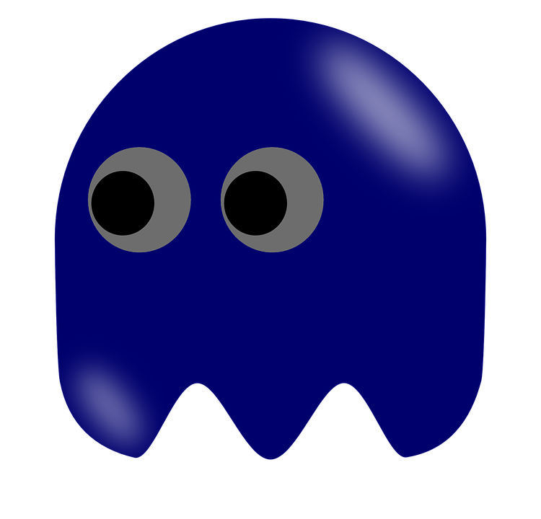
Game Board - CSS code
This is the board layout. We were able to use a cursor image of pacman for the pointer which is a key game piece.
.board {
float: down;
width: 1000px;
height: 600px;
margin: 40px auto;
background: #69c url(http://nojsgame.majorov.su/bg.jpg);
cursor: image;
cursor: url("pac_cursor.jpg"), auto;
text-align: center;
position: relative;
}

Slide 7
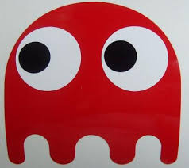
Ghost and Ghost movement - CSS code
Each ghost has the same design specifications. What makes each ghost different is its color and the speed it moves across the screen. The animation selector is where the ghost speed and path type are specified. Also we adjusted the amount of pixels from the top of the board to indicate it’s location on the screen. The @keyframe specifies the animation. It changes the CSS style by each percentage from the beginning of the animation to the end.
.clyde{
background: #ff9f00;
width: 50px;
height: 50px;
border-radius: 50% 50% 0% 0%;
animation: ghost 5s .05s infinite linear;
position: absolute;
top: 150px;
}
@-webkit-keyframes ghost{
0%{left: 10%;}
50%{left: 70%;}
100%{left: 10%;}
}

Slide 8
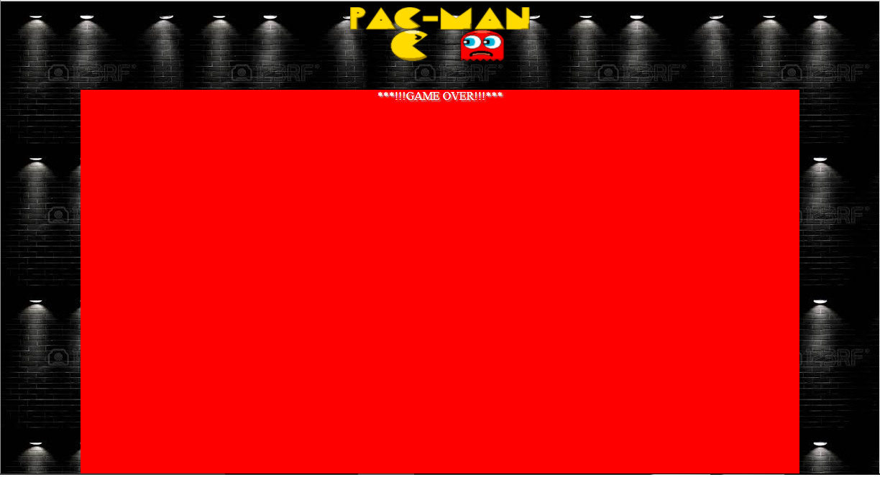
“Game Over” Display

Slide 9
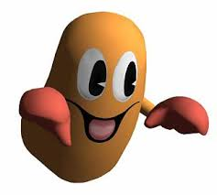
“Game Over” screen on hoover – CSS code
The hover pseudocode was used to trigger the “Game Over” display. When you hover over the ghost a box fills the game board portion of the screen.
.board .clyde:hover {
border-radius: 0;
margin: 0;
height: 2000px;
width: 1000px;
position: absolute;
top: 0;
left: 0;
z-index: 999;
background: #f00;
overflow: visible;
cursor: not-allowed;
-webkit-animation: animation1 0s 0s linear !important;
animation: animation1 0s 0s linear !important;
}

Slide 10
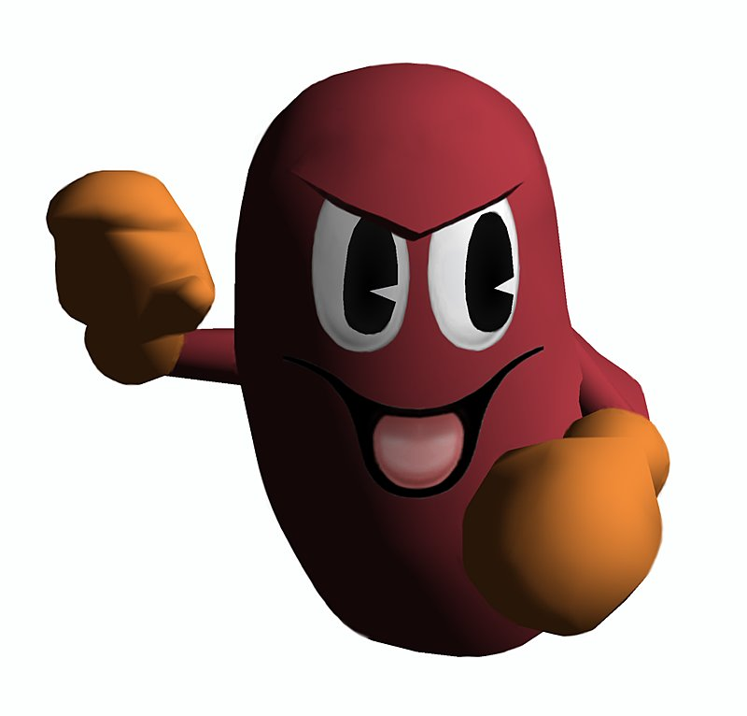
“Game Over” text display – CSS code
The hover:before and hover:after pseudocode specifies the action of the hover. When you hover on the ghost, the hover:before allows us to change the color of the game board to red and displays the text “Game Over” as specified under content. In hover:after when you move the cursor from the ghost there is no display and the game continues as before so you can restart from where you left off.
.board .clyde:hover:before {
background: #f00;
content: "***!!!GAME OVER!!!***";
top: 800;
left: 0;
width: 1000;
color: #fff;
text-shadow: 2px 2px 2px #aaa;
box-shadow: none;
}
.board .clyde:hover:after {
display: none;
}

Slide 11

“You Won” Display

Slide 12
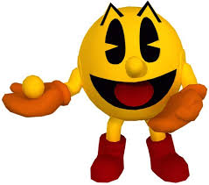
“You Won” - HTML Page
The “You Won” page has it’s own HTML that uses classed for its design and features. This allows the page to be removed or changed more easily and efficiently. The CSS classes used are in contained in the CSS Stylesheet, which is the only stylesheet used for the game.
<!DOCTYPE html>
<html>
<head>
<link rel ="stylesheet" type="text/css" href="pacman.css">
<title> Pacman's Pursuit </title>
</head>
<body class="youwon_page">
<div>
<h1 class="flash">****YOU WON****</h1>
</div>
<div>
<h1 class="flash">****YOU WON****</h1>
</div>
<div>
<h1 class="flash">****YOU WON****</h1>
</div>
</body>
</html>

Slide 13
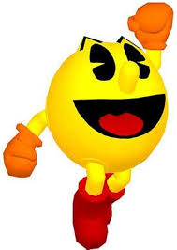
Flashing “You Won” text - CSS code
The flash selector indicates the type of animation used and how long each flash will last. The iteration is infinite so it is ongoing and never stops. The flash keyframe, again, indicates the style changes.
.flash {
animation-name: flash;
animation-duration: 0.2s;
animation-timing-function: linear;
animation-iteration-count: infinite;
animation-direction: alternate;
animation-play-state: running;
}
@keyframes flash {
from {color: red;}
to {color: black;}
}

Slide 14

Thanks for Playing

